Slide 1
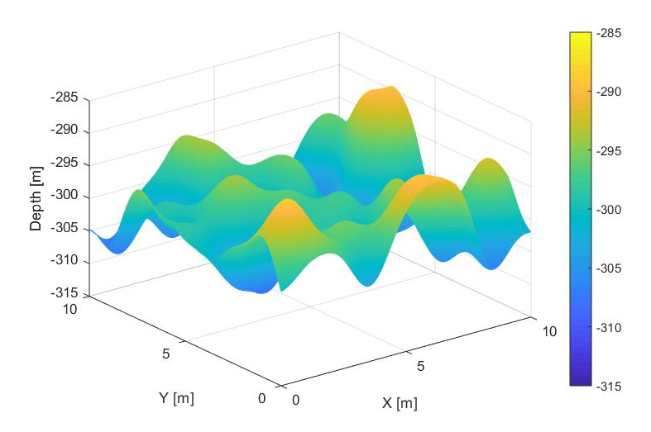
Bathymetry interpolation algorithms using AUV mission data
Alessia Annecchini
Alessia Guida
Lorenzo Irace
Giuseppe Longo

Slide 2
Lineup
Ideal cases
Seabed shapes
Interface
Seabed types
Water absorption coefficient
Noise
Outliers

Slide 3
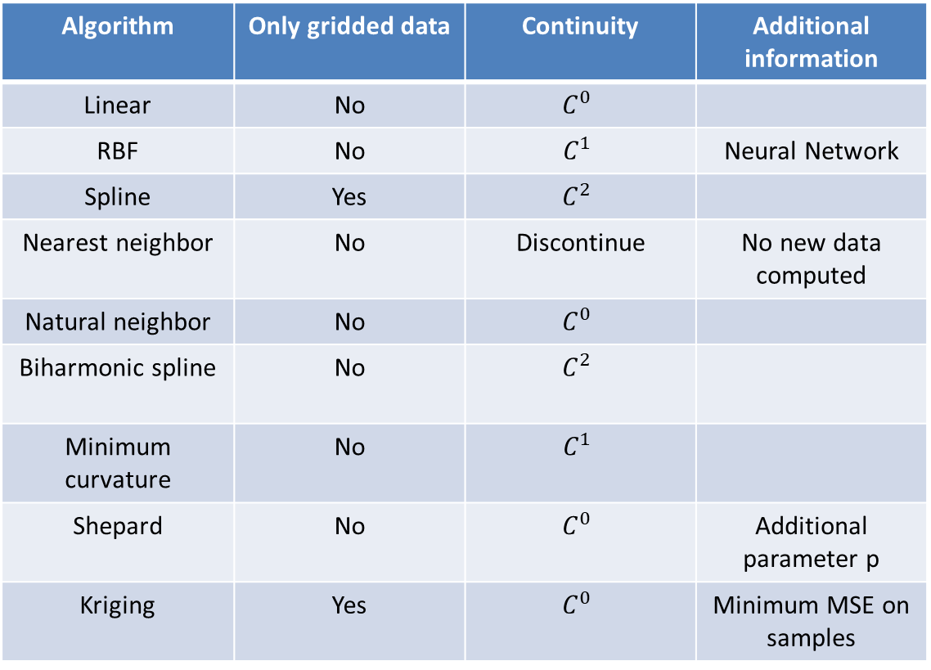
Tested algorithms
Algorithm | Only gridded data | Continuity | Additional information
Linear | No | $$C^{0}$$
RBF | No | $$C^{1}$$ | Neural Network
Spline | Yes | $$C^{2}$$
Nearest neighbor | No | Discontinue | No new data computed
Natural neighbor | No | $$C^{0}$$
Biharmonic spline | No | $$C^{2}$$
Minimum curvature | No | $$C^{1}$$
Shepard | No | $$C^{0}$$ | Additional parameter p
Kriging | Yes | $$C^{0}$$ | Minimum MSE on samples

Slide 4
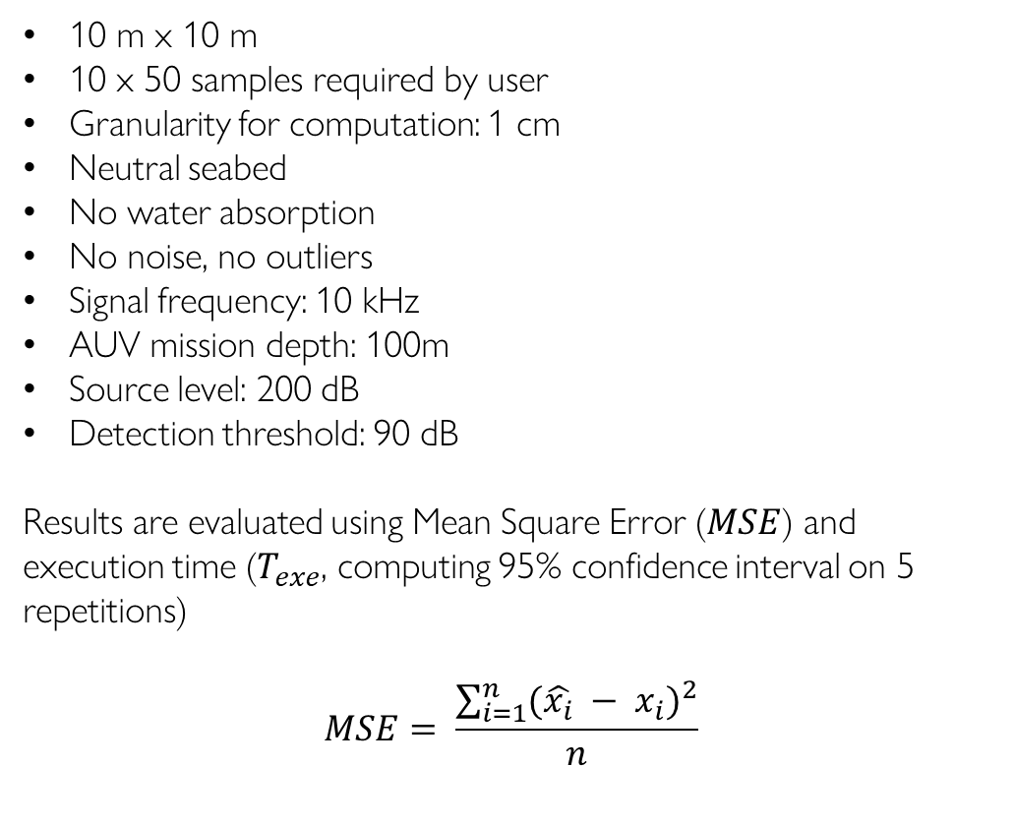
Ideal case parameters
10 m x 10 m
10 x 50 samples required by user
Granularity for computation: 1 cm
Neutral seabed
No water absorption
No noise, no outliers
Signal frequency: 10 kHz
AUV mission depth: 100m
Source level: 200 dB
Detection threshold: 90 dB
Results are evaluated using Mean Square Error ($MSE$) and execution time ($T_{exe}$, computing 95% confidence interval on 5 repetitions)
$$MSE= \frac{\sum_{i=1}^{n}{{(\hat{x_{i}} − x_{i})}^{2}}}{n}$$

Slide 5
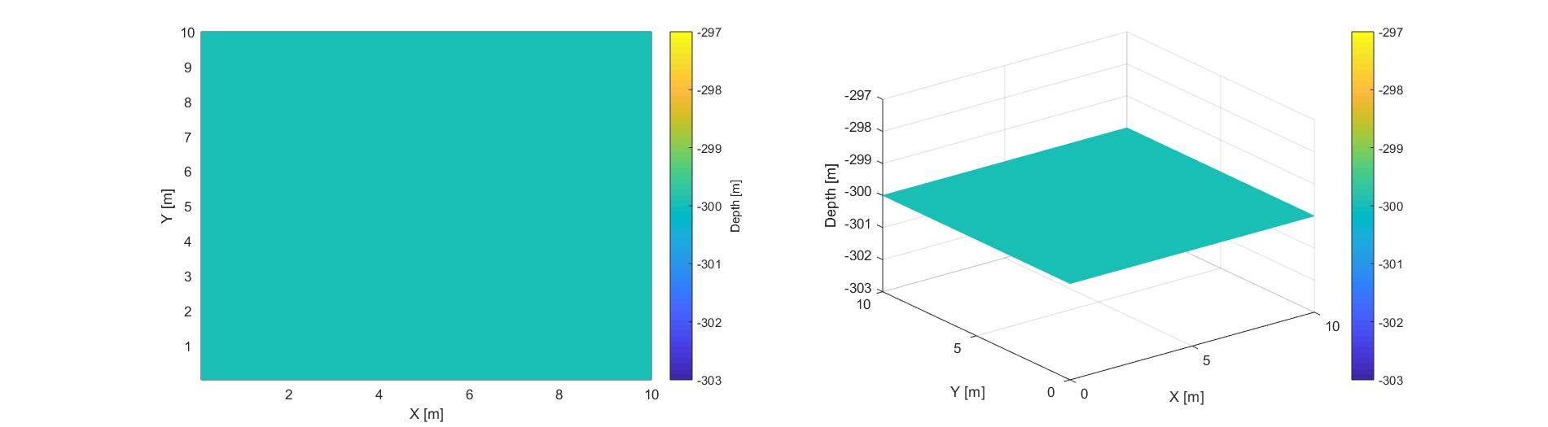
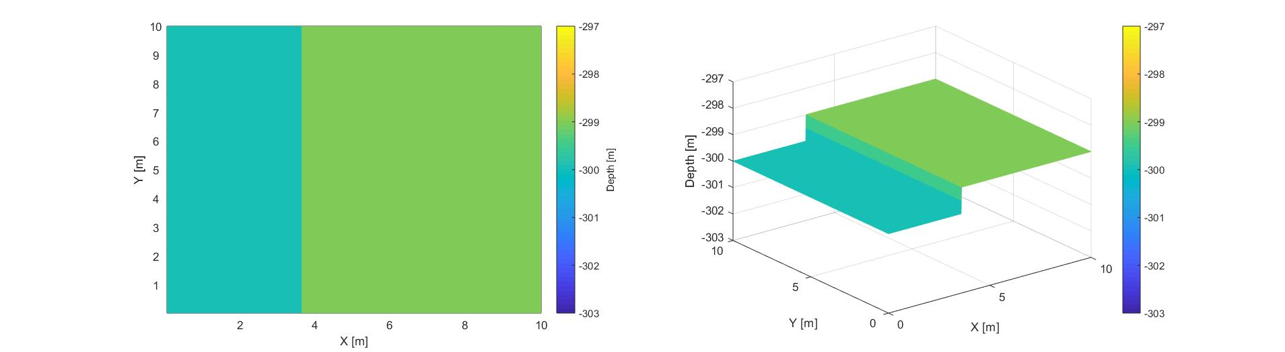
Seabed shapes
Plane
Step

Slide 6
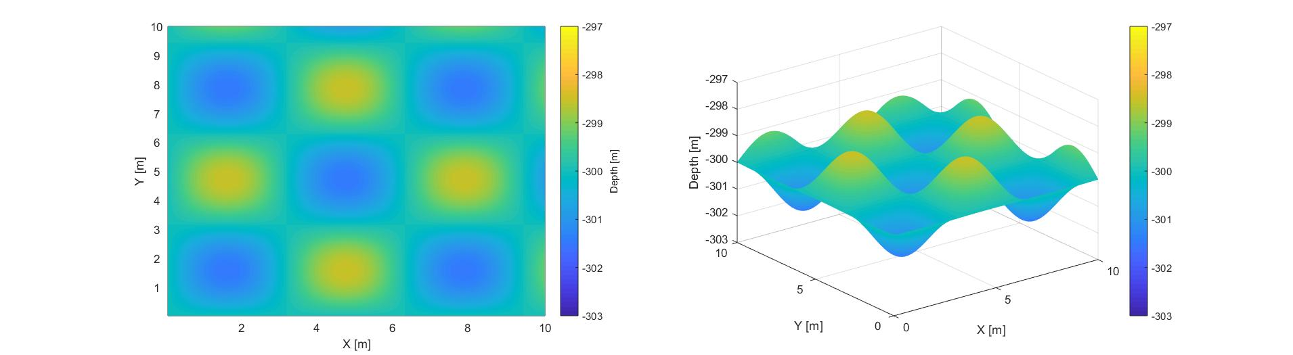

Seabed shapes
Product of sinusoids
Random Gaussian surface

Slide 7
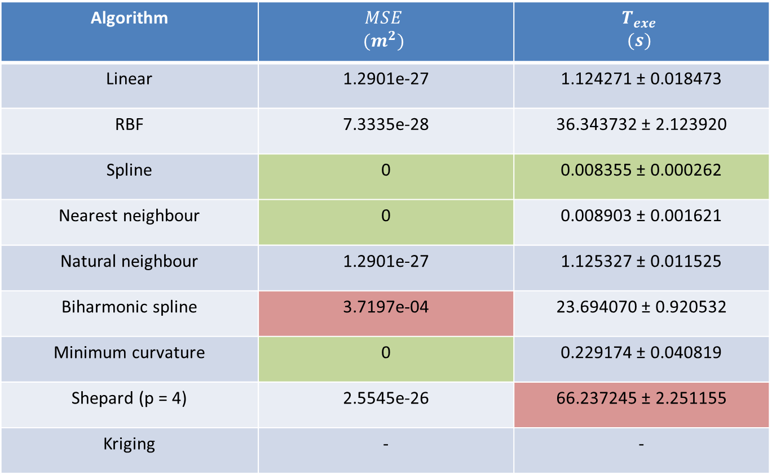
Plane seabed: results
Algorithm | $$MSE$$ $$(m^{2})$$ | $$T_{exe}$$ $$(s)$$
Linear | 1.2901e-27 | 1.124271 ± 0.018473
RBF | 7.3335e-28 | 36.343732 ± 2.123920
Spline | 0 | 0.008355 ± 0.000262
Nearest neighbour | 0 | 0.008903 ± 0.001621
Natural neighbour | 1.2901e-27 | 1.125327 ± 0.011525
Biharmonic spline | 3.7197e-04 | 23.694070 ± 0.920532
Minimum curvature | 0 | 0.229174 ± 0.040819
Shepard (p = 4) | 2.5545e-26 | 66.237245 ± 2.251155
Kriging | - | -

Slide 8
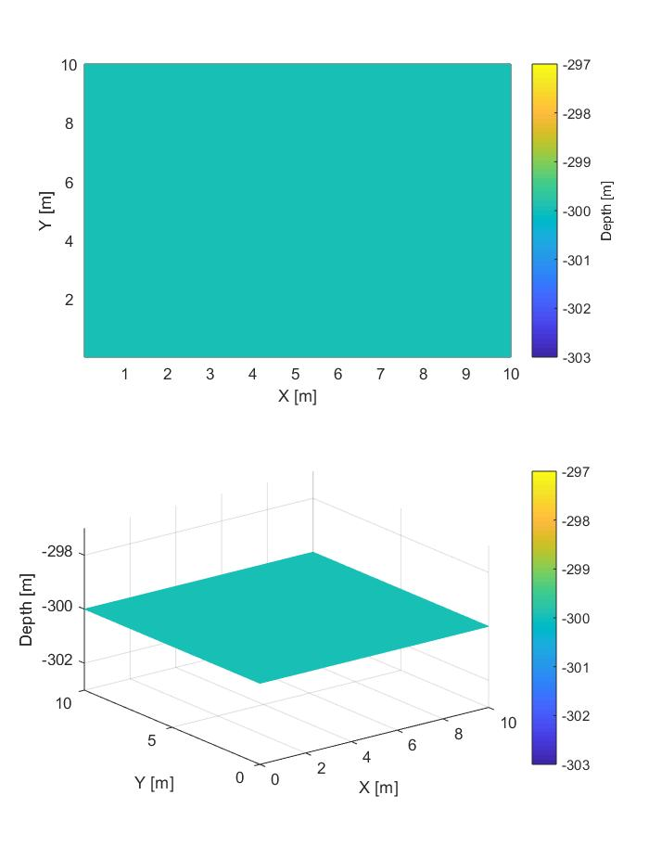
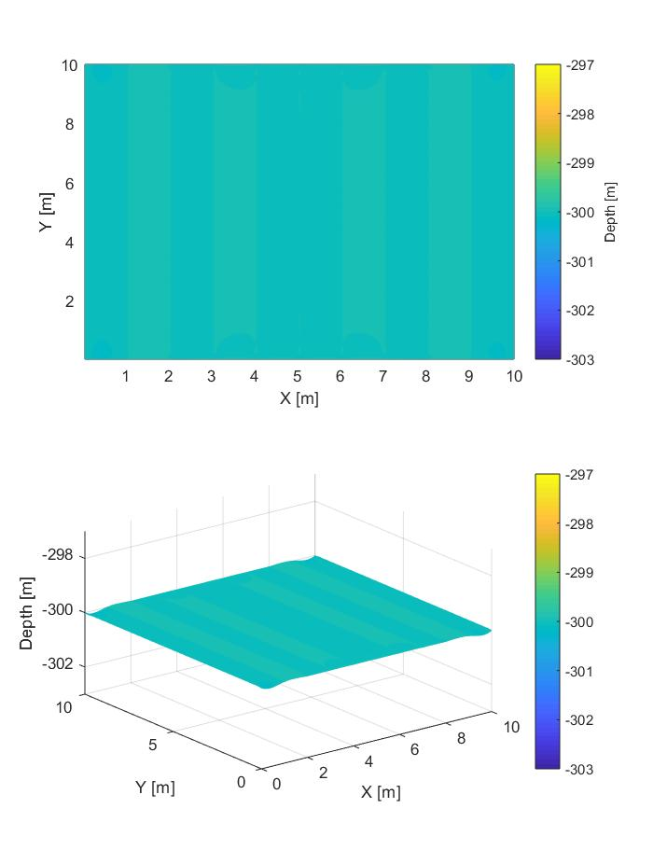
Plane seabed: results
Original
Spline
Biharmonic spline

Slide 9
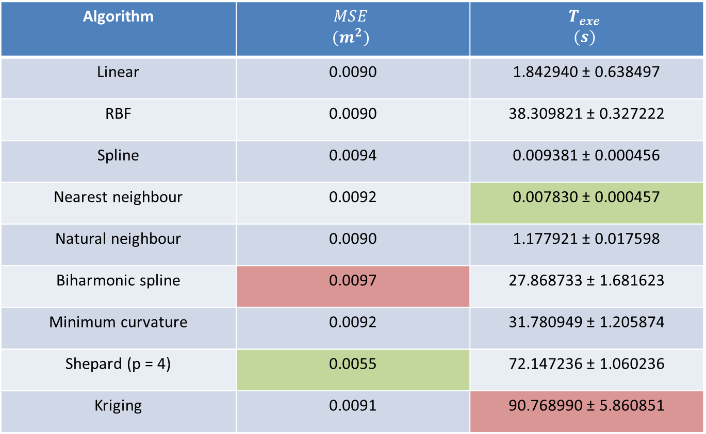
Step seabed: results
Algorithm | $$MSE$$ $$(m^{2})$$ | $$T_{exe}$$ $$(s)$$
Linear | 0.0090 | 1.842940 ± 0.638497
RBF | 0.0090 | 38.309821 ± 0.327222
Spline | 0.0094 | 0.009381 ± 0.000456
Nearest neighbour | 0.0092 | 0.007830 ± 0.000457
Natural neighbour | 0.0090 | 1.177921 ± 0.017598
Biharmonic spline | 0.0097 | 27.868733 ± 1.681623
Minimum curvature | 0.0092 | 31.780949 ± 1.205874
Shepard (p = 4) | 0.0055 | 72.147236 ± 1.060236
Kriging | 0.0091 | 90.768990 ± 5.860851

Slide 10
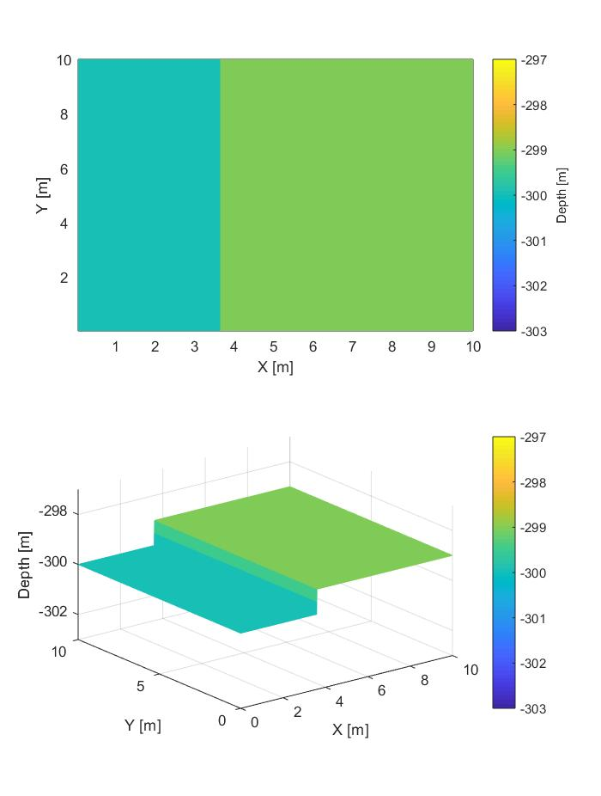

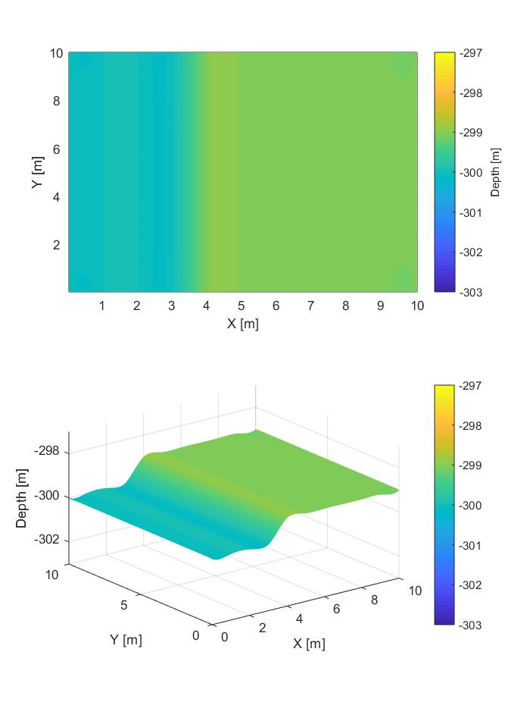
Step seabed: results
Original
Shepard
Biharmonic spline

Slide 11

Step seabed: results
Original
Shepard
Natural neighbour

Slide 12
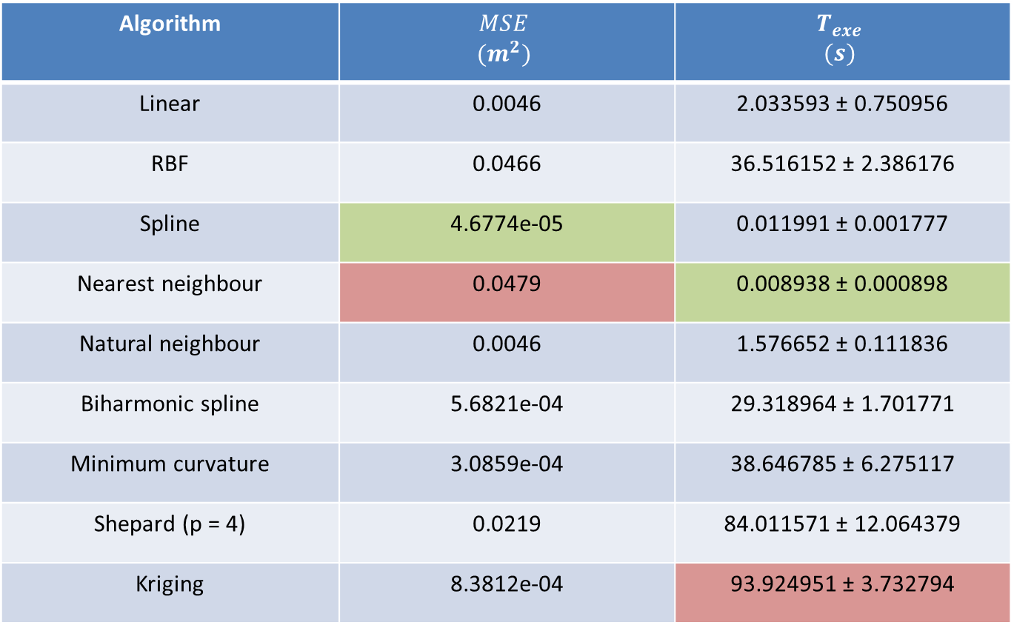
Sinusoidal seabed: results
Algorithm | $$MSE$$ $$(m^{2})$$ | $$T_{exe}$$ $$(s)$$
Linear | 0.0046 | 2.033593 ± 0.750956
RBF | 0.0466 | 36.516152 ± 2.386176
Spline | 4.6774e-05 | 0.011991 ± 0.001777
Nearest neighbour | 0.0479 | 0.008938 ± 0.000898
Natural neighbour | 0.0046 | 1.576652 ± 0.111836
Biharmonic spline | 5.6821e-04 | 29.318964 ± 1.701771
Minimum curvature | 3.0859e-04 | 38.646785 ± 6.275117
Shepard (p = 4) | 0.0219 | 84.011571 ± 12.064379
Kriging | 8.3812e-04 | 93.924951 ± 3.732794

Slide 13
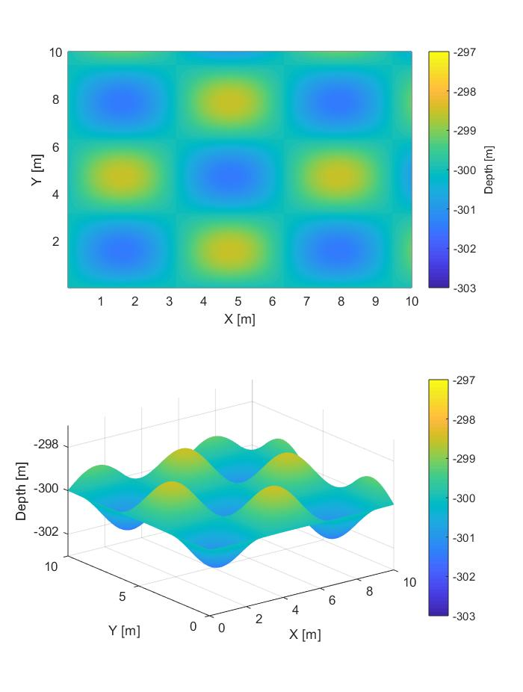

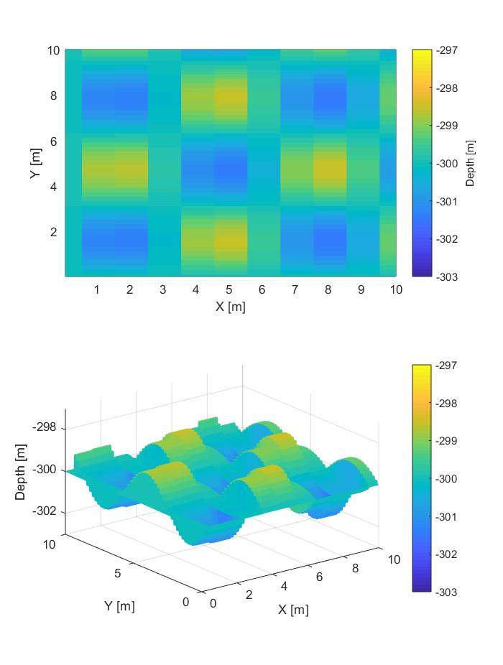
Sinusoidal seabed: results
Original
Spline
Nearest neighbour

Slide 14
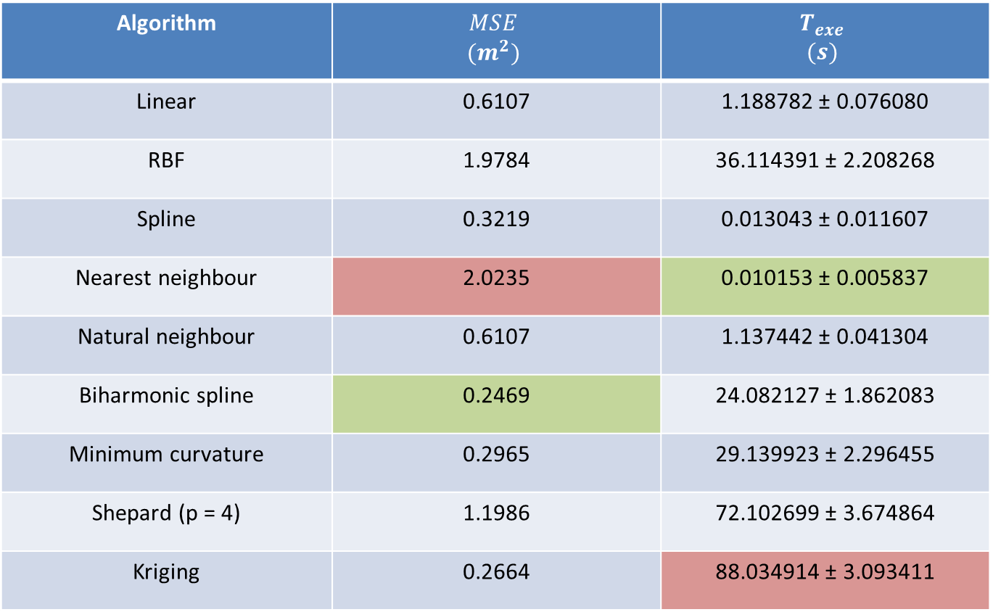
Gaussian seabed: results
Algorithm | $$MSE$$ $$(m^{2})$$ | $$T_{exe}$$ $$(s)$$
Linear | 0.6107 | 1.188782 ± 0.076080
RBF | 1.9784 | 36.114391 ± 2.208268
Spline | 0.3219 | 0.013043 ± 0.011607
Nearest neighbour | 2.0235 | 0.010153 ± 0.005837
Natural neighbour | 0.6107 | 1.137442 ± 0.041304
Biharmonic spline | 0.2469 | 24.082127 ± 1.862083
Minimum curvature | 0.2965 | 29.139923 ± 2.296455
Shepard (p = 4) | 1.1986 | 72.102699 ± 3.674864
Kriging | 0.2664 | 88.034914 ± 3.093411

Slide 15
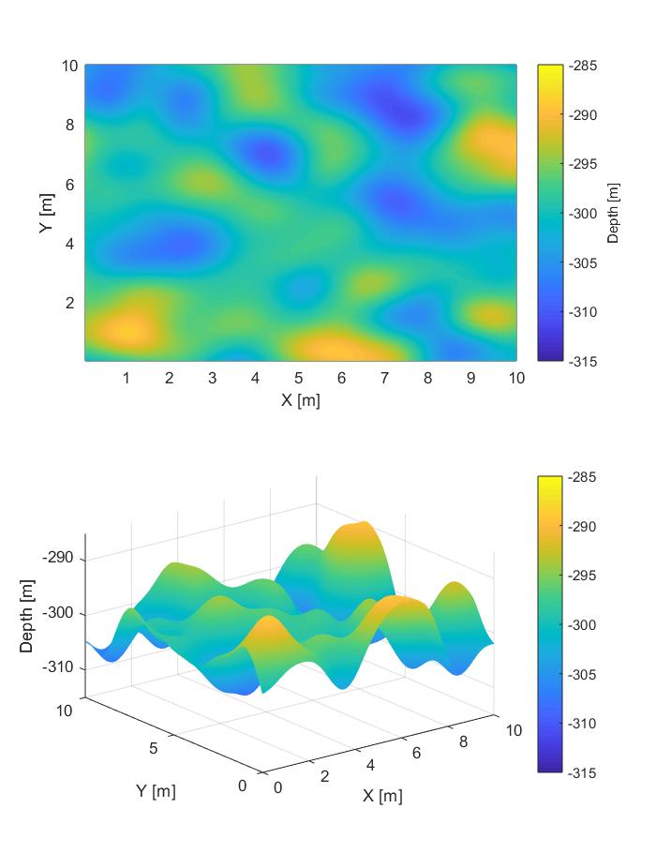
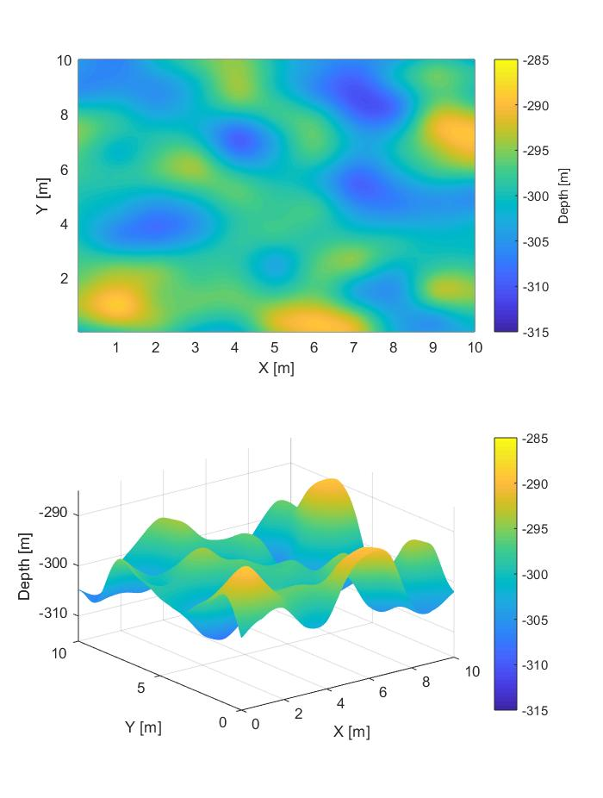
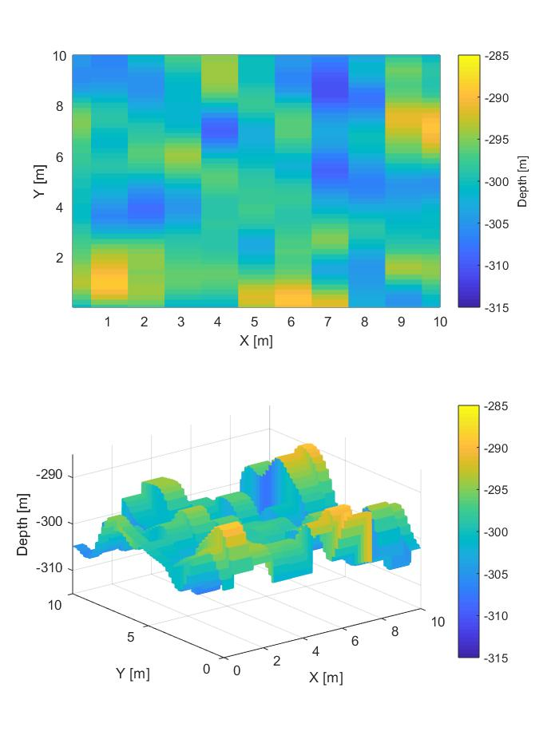
Gaussian seabed: results
Original
Biharmonic spline
Nearest neighbour

Slide 16

Gaussian seabed: results
Original
Biharmonic spline
Spline

Slide 17
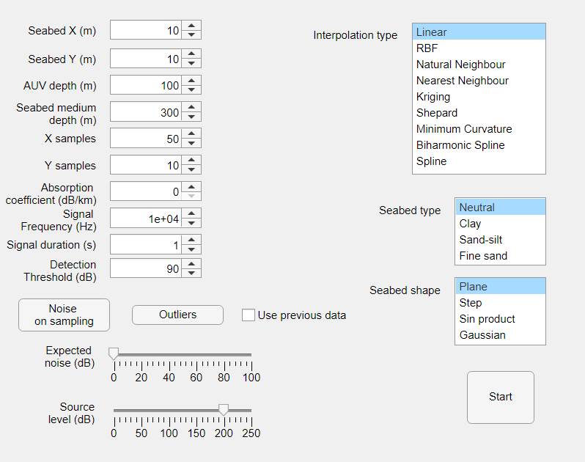
Application GUI
Created using Matlab appdesigner tool
Output: seabed map, interpolated map, execution time and mean square error
Use previous data allows to run different interpolation techniques without repeating the mission simulation

Slide 18

Seabed types
$$S=SL −2TL+TS$$
Signal reflection is influenced by seabed type
This influenced can be taken in account by modifying the target strength parameter
Commonly used values can be found in literature
Type | TS (dB)
Clay | -21.8
Silty Clay | -18.0
Clayey | -13.8
Sand-Silt-Clay | -12.1
Sand-Silt | -10.7
Silty Sand | -9.7
Very Fine Sand | -8.9
Fine Sand | -8.3
Coarse Sand | -7.7
(From Lurton An Introduction to UWA, 2nd Ed., 2010)

Slide 19

Water absorption
$$TL=40\log_{10}{R}− αR$$
Water absorbs signal power linearly
Coefficient depends on signal frequency and water temperature
Commonly used values can be found in literature
Temperature (°C) | Absorption (dB/km)
 | Frequency (kHz)
 | 0.5 | 1 | 2 | 5 | 10 | 20
0 | 0.03 | 0.07 | 0.14 | 0.41 | 1.3 | 4.6
10 | 0.02 | 0.07 | 0.14 | 0.33 | 0.92 | 3.2
20 | 0.02 | 0.06 | 0.13 | 0.30 | 0.70 | 2.2
30 | 0.01 | 0.05 | 0.13 | 0.29 | 0.58 | 1.6
Engineering ToolBox, (2014). Sea Water - Attenuation of Sound

Slide 20
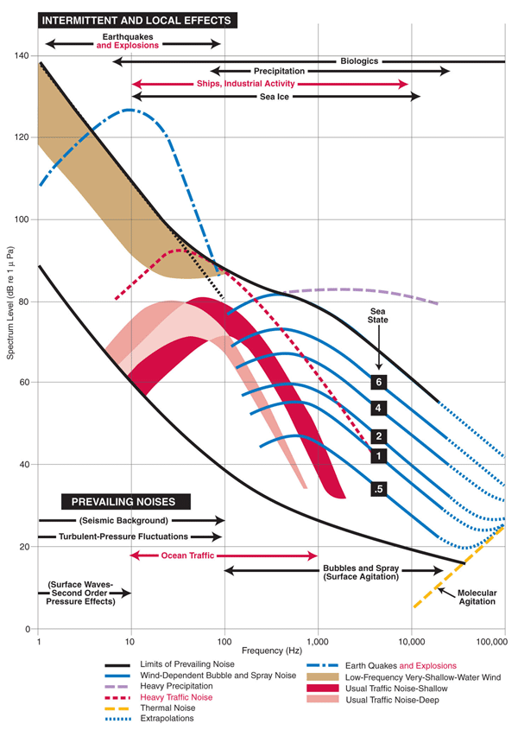
Noise and measurement errors
In the real world sampling is affected by noise
Various sources
Ambient conditions (sea state, wind)
Vehicles (traffic and AUV itself)
Measurement errors can also be present
Incorrect sensor position
Imperfections
Systematic errors can be present but they can be easily corrected too (thus they are supposed as not present)
Noise approximations can be found in literature
Any variation from that approximation is modeled as a white gaussian process

Slide 21
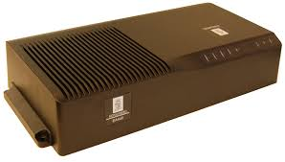
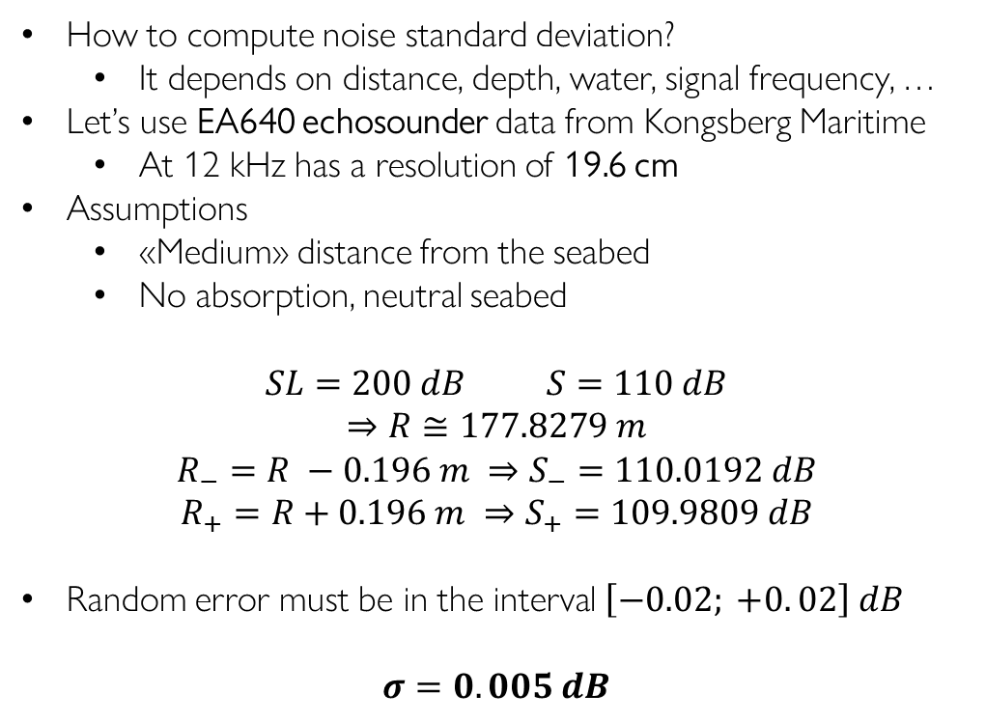
Noise standard deviation
How to compute noise standard deviation?
It depends on distance, depth, water, signal frequency, …
Let’s use EA640 echosounder data from Kongsberg Maritime
At 12 kHz has a resolution of 19.6 cm
Assumptions
«Medium» distance from the seabed
No absorption, neutral seabed
$$SL=200 dB S=110 dB$$
$$⇒R≅177.8279 m$$
$$R_{−}=R −0.196 m ⇒S_{−}=110.0192 dB$$
$$R_{+}=R+0.196 m ⇒S_{+}=109.9809 dB$$
Random error must be in the interval $\left[−0.02; +0. 02\right] dB$
$σ=0.005 dB$

Slide 22
Interpolation with noise
Small noise
The first test is done with not filtered data
Testing how methods are influenced by not perfect data
Filtering data can improve performances
Different filters can change interpolation method results
To do: evaluate performances with different filters

Slide 23
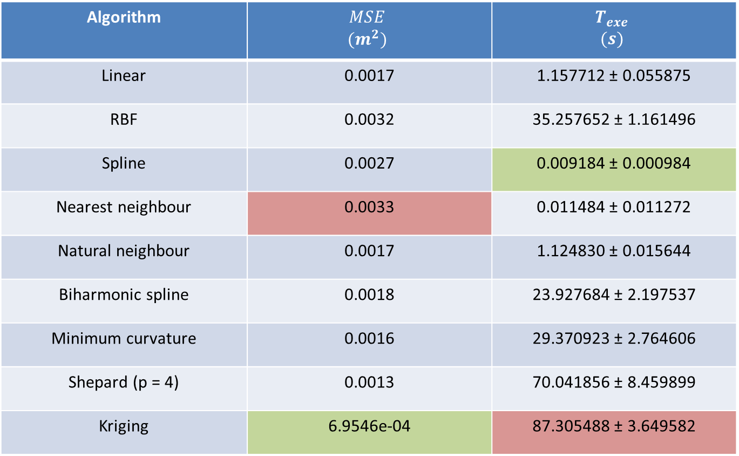
Plane seabed: results
Algorithm | $$MSE$$ $$(m^{2})$$ | $$T_{exe}$$ $$(s)$$
Linear | 0.0017 | 1.157712 ± 0.055875
RBF | 0.0032 | 35.257652 ± 1.161496
Spline | 0.0027 | 0.009184 ± 0.000984
Nearest neighbour | 0.0033 | 0.011484 ± 0.011272
Natural neighbour | 0.0017 | 1.124830 ± 0.015644
Biharmonic spline | 0.0018 | 23.927684 ± 2.197537
Minimum curvature | 0.0016 | 29.370923 ± 2.764606
Shepard (p = 4) | 0.0013 | 70.041856 ± 8.459899
Kriging | 6.9546e-04 | 87.305488 ± 3.649582

Slide 24

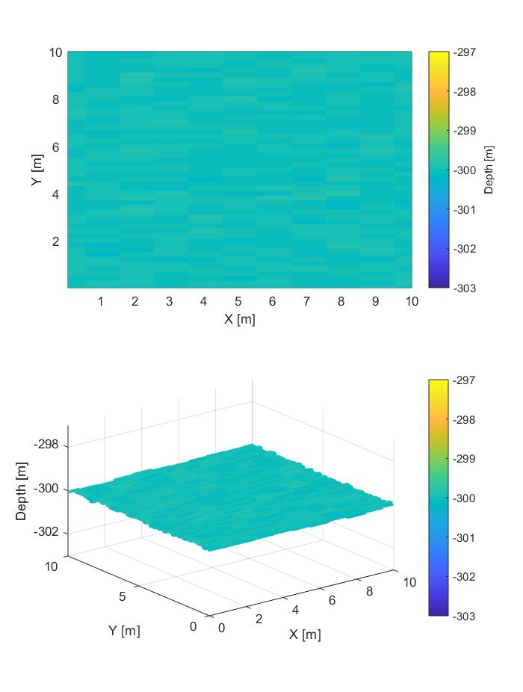
Plane seabed: results
Original
Kriging
Nearest neighbour

Slide 25

Plane seabed: results
Original
Kriging
Natural neighbour

Slide 26
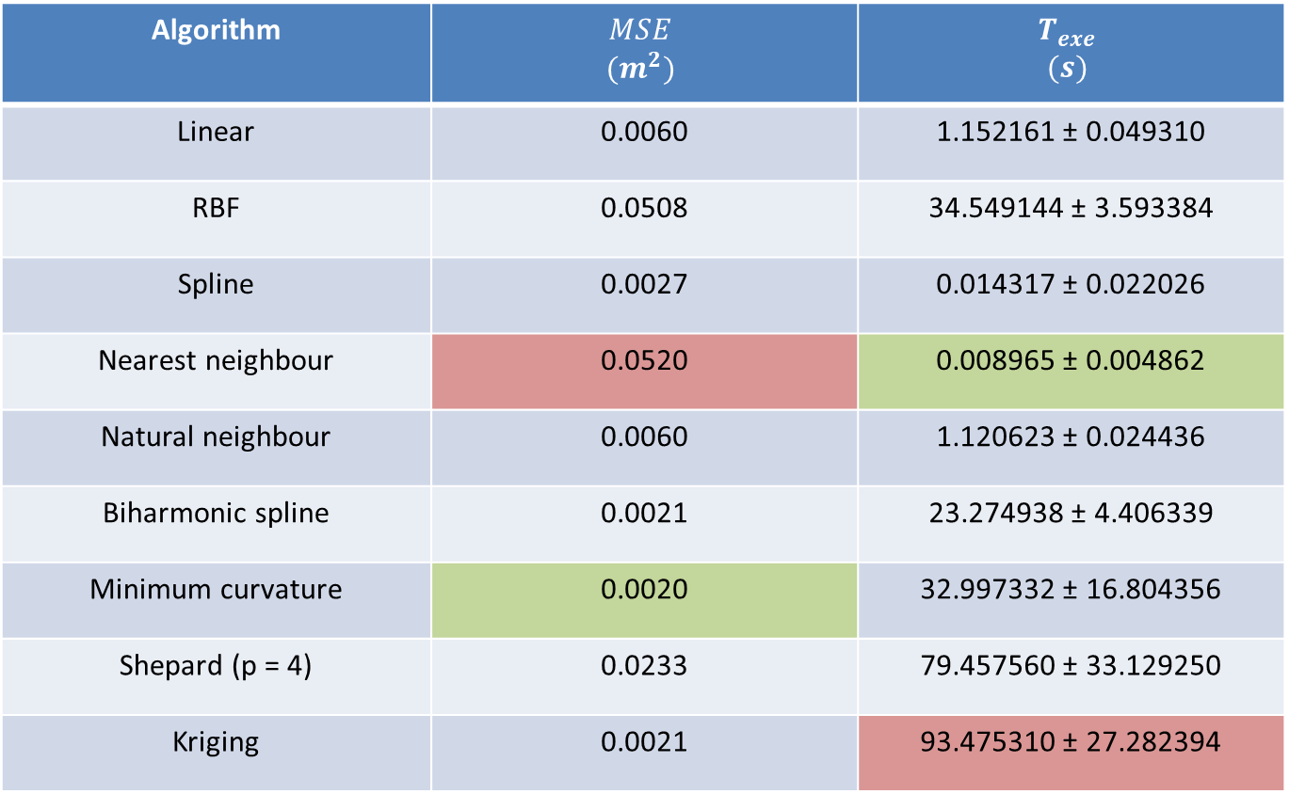
Sinusoidal seabed: results
Algorithm | $$MSE$$ $$(m^{2})$$ | $$T_{exe}$$ $$(s)$$
Linear | 0.0060 | 1.152161 ± 0.049310
RBF | 0.0508 | 34.549144 ± 3.593384
Spline | 0.0027 | 0.014317 ± 0.022026
Nearest neighbour | 0.0520 | 0.008965 ± 0.004862
Natural neighbour | 0.0060 | 1.120623 ± 0.024436
Biharmonic spline | 0.0021 | 23.274938 ± 4.406339
Minimum curvature | 0.0020 | 32.997332 ± 16.804356
Shepard (p = 4) | 0.0233 | 79.457560 ± 33.129250
Kriging | 0.0021 | 93.475310 ± 27.282394

Slide 27

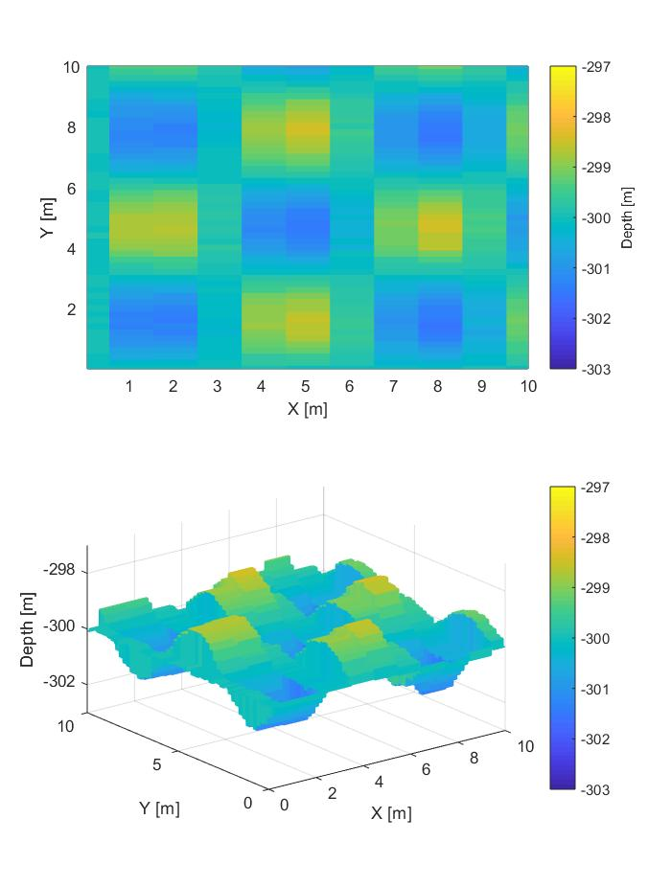
Sinusoidal seabed: results
Original
Minimum curvature
Nearest neighbour

Slide 28

Sinusoidal seabed: results
Original
Minimum curvature
Spline

Slide 29
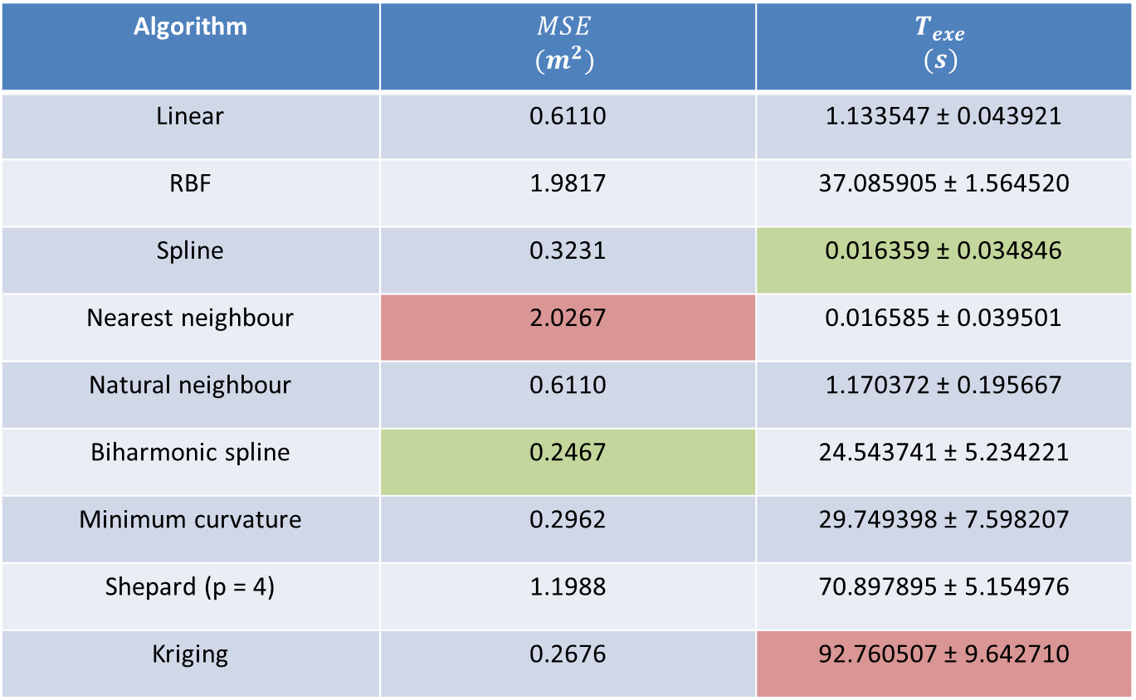
Gaussian seabed: results
Algorithm | $$MSE$$ $$(m^{2})$$ | $$T_{exe}$$ $$(s)$$
Linear | 0.6110 | 1.133547 ± 0.043921
RBF | 1.9817 | 37.085905 ± 1.564520
Spline | 0.3231 | 0.016359 ± 0.034846
Nearest neighbour | 2.0267 | 0.016585 ± 0.039501
Natural neighbour | 0.6110 | 1.170372 ± 0.195667
Biharmonic spline | 0.2467 | 24.543741 ± 5.234221
Minimum curvature | 0.2962 | 29.749398 ± 7.598207
Shepard (p = 4) | 1.1988 | 70.897895 ± 5.154976
Kriging | 0.2676 | 92.760507 ± 9.642710

Slide 30


Gaussian seabed: results
Original
Biharmonic spline
Nearest neighbour

Slide 31

Gaussian seabed: results
Original
Biharmonic spline
Spline

Slide 32
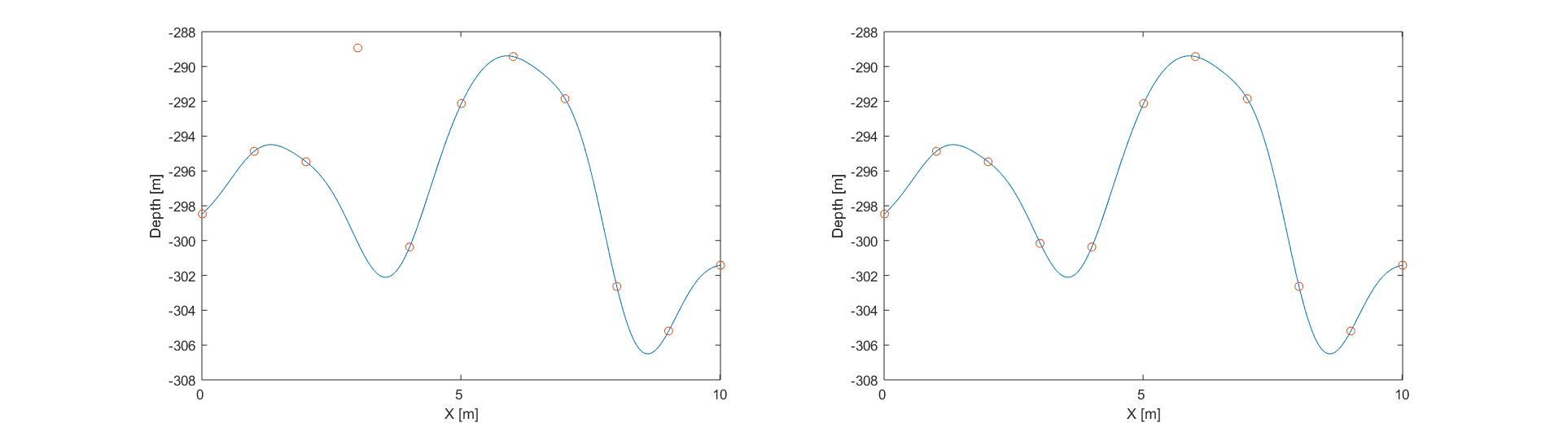
Outliers
An outlier is a data point that differs significantly from other observations
Higher magnitude than noise
Randomly generated
Matlab implements a function filloutliers which identifies and replaces outliers accordingly to the methods specified
Parameters used during the test
‘fillmethod’ → ‘linear’
‘findmethod’ → ‘gesd’
To do: evaluate performances with different outlier rejection methods

Slide 33

Gaussian seabed: results
Algorithm | $$MSE$$ $$(m^{2})$$ | $$T_{exe}$$ $$(s)$$
Linear | 1.9376 | 1.142084 ± 0.057689
RBF | 4.6118 | 35.467171 ± 2.425831
Spline | 2.3057 | 0.009045 ± 0.002736
Nearest neighbour | 4.7534 | 0.009538 ± 0.008649
Natural neighbour | 1.9376 | 1.227960 ± 0.343342
Biharmonic spline | 1.5204 | 24.222599 ± 7.057993
Minimum curvature | 1.5892 | 29.524162 ± 7.098045
Shepard (p = 4) | 2.2852 | 71.082204 ± 6.056565
Kriging | 1.2212 | 89.495209 ± 6.475687

Slide 34
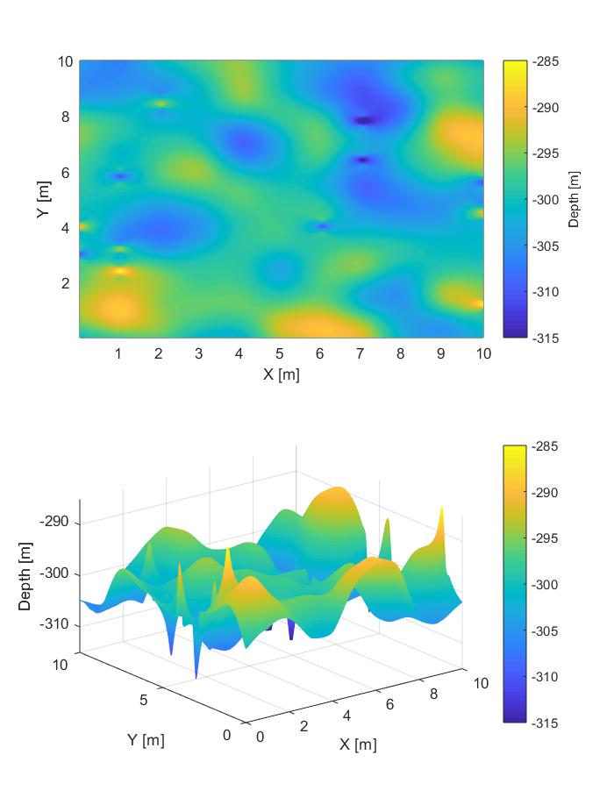
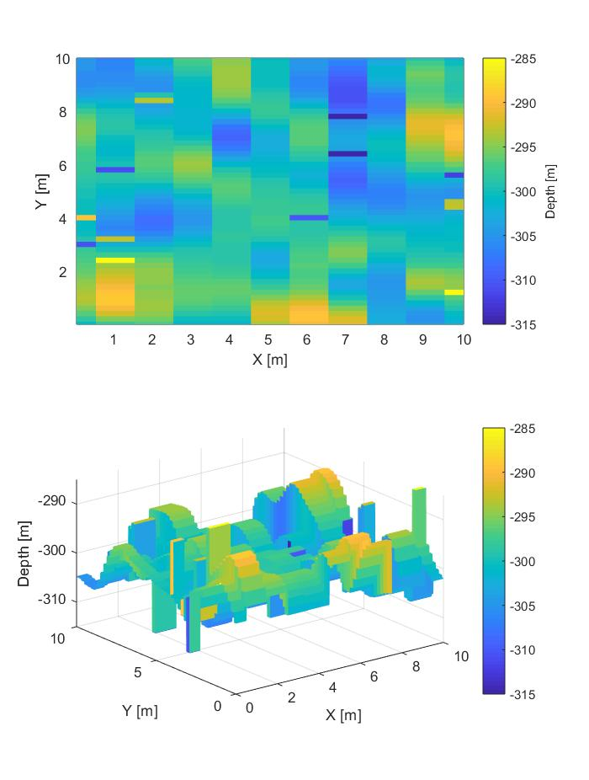
Gaussian seabed: results
Original
Kriging
Nearest neighbour

Slide 35

Gaussian seabed: results
Original
Kriging
Linear

Slide 36
To do
Noise filtering
Different outliers rejection
Simulations with both noise and outliers
Performances increasing and decreasing number of samples
Physical mission bounds

